Slide 1



FEMCURE
FUTURISTIC RESEARCH & INNOVATION LAB

Slide 2

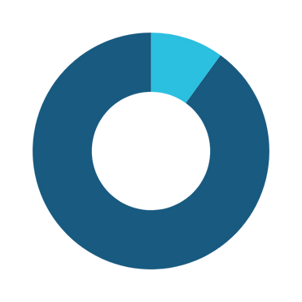
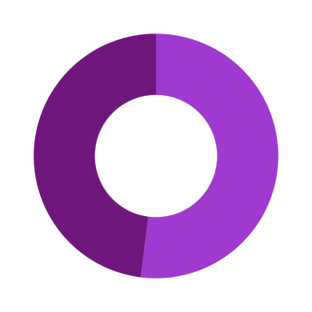



THE SILENT CRISIS: Undiagnosed PCOS
GLOBAL STATISTICS
NATIONAL STATISTICS
6-13%
52%
116M (3.4% of total female population)
18.36M (15.6% of all women in Pakistan)
70% UNDIAGNOSED
80% UNDIAGNOSED
Sources: World Health Organization (2023), BMC Women's Health Journal (2024), Dawn News Report (2025)

Slide 3



The Hidden Toll of PCOS
Long Term Health Risks
Undiagnosed PCOS isn’t just a hormonal issue—it’s a metabolic time bomb. Early intervention could prevent billions in downstream healthcare costs.
Hirsutism/
Acne/
Mood swings
Weight gain
Hair Loss
>50% develop type II diabetes by age of 40(NIH,2022)
4x higher risk of endometrial cancer (ACOG,2023)
#1 cause of infertility in Pakistan (4/10 cases) (NIH,2023)
44%
Irregular
Menstrual
Cycle
Of women with PCOS are unaware(Donna Report)
Infertility
(Sources: NIH, WHO, ACOG)

Slide 4



THE SOLUTION - FEMCURE
Identifies high-risk women 3-5 years before severe symptoms arises
AI-powered PCOS Prediction
Preventive Care
Tools
Personalized lifestyle plans(diets/exercise)
Progress monitoring
Experts
Consultation
Transforming 44% unaware women into empowered women – stopping PCOS before it starts
Awareness & Symptoms Tracking

Slide 5
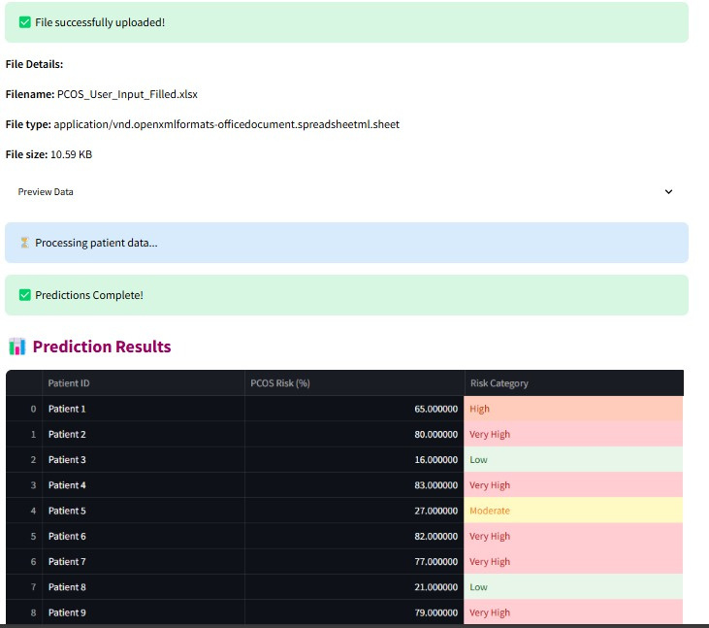
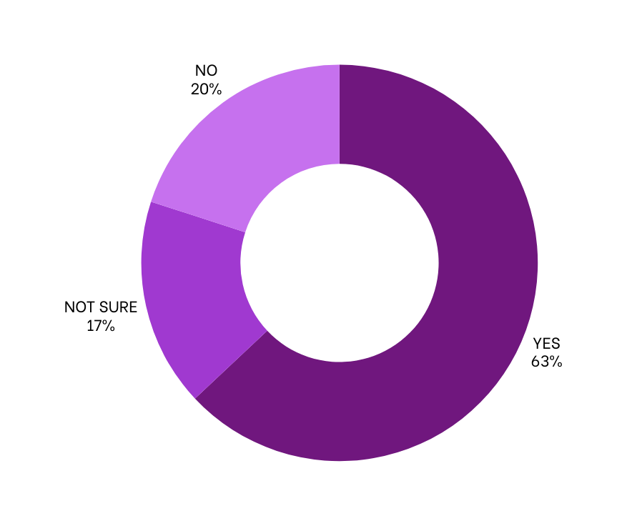
VALIDATION
CLINICAL PROTOTYPE
USER VALIDATION
Developed with Dr. Ramsha J Haider & Dr. Aniqa Dilawari
Surveyed 817 women in female institute.
63% reported need for such a solution
Accuracy : 88%

Slide 6




MARKET OPPORTUNITY
Target :Women aged 15–45 in Pakistan (34M total)
TAM
34M
All women aged 15–45 in Pakistan
SAM
8M
Women with access to smartphones/internet in urban & semi-urban areas
SOM
120k
Initial reachable market (urban students, working women)
Source: (Pakistan Bureau of Statistics, 2023)

Slide 7


Global FemTech Market Opportunity
55.86B(2024)→130.80B by 2034 (8.88% CAGR)
Source : Femtch Analytics Report 2024

Slide 8
GO-TO-MARKET STRATEGY
Phase | Target Segment | Key Actions
Phase 1 (0–12 months) Validate & Seed | Urban Early Adopters(5M women, 120K target) | Freemium model Premium (PKR 299/-) 20+ university partnerships Performance ads Campus ambassador program
Phase 2 (12–24 months) Scale | Urban/Semi-Urban Families(3M women, 500K target) | Group plans (PKR 200–400/user) Localized WhatsApp communities Pharmacy/OTC partnerships Micro-influencer campaigns
Phase 3 (24–36 months) Rural Expansion | "Digitally Adjacent" Rural Women(5M women, 250K target) | 500 trained ambassadors SMS/IVR health tools (zero-data cost) Sachet products (PKR 65)

Slide 9
FemCure Revenue Roadmap
Stream | Phase 1 (0-12months) | Phase 2 (12-36 months) | Phase 3 (36+ months) | Key Benefits
Subscriptions | ₨ 299/user/month | + Corporate plans | + Multilingual | Personalized Plans Community Forums
Kits | Small (₨390) | Med/Large (Rs. 650+) | Bulk (₨300/unit) | Herbal Solutions Tiered pricing
Services | Ads (₨50/1K views) | Doctor Consults (₨1K/session) | AI SaaS Licensing | Verified specialists Early detection
Revenue/Year | ₨8.1M | ₨30.0M | ₨40.5M

Slide 10


FemCure’s Scalability & Milestones
Phase | How We Scale | Key Actions | Target
Phase 1 (0-12mo) | • App grows virally • Low-cost kits | • Launch in 10 colleges • Partner with 5 clinics | • 5,000 users
Phase 2 (12-36mo) | • Add paid services • Expand cities | • Onboard specialists • Corporate wellness deals | • 50,000 users
Phase 3 (36+mo) | • Bulk contracts • National SMS alerts | • Rural awareness drives | • 200,000 users

Slide 11
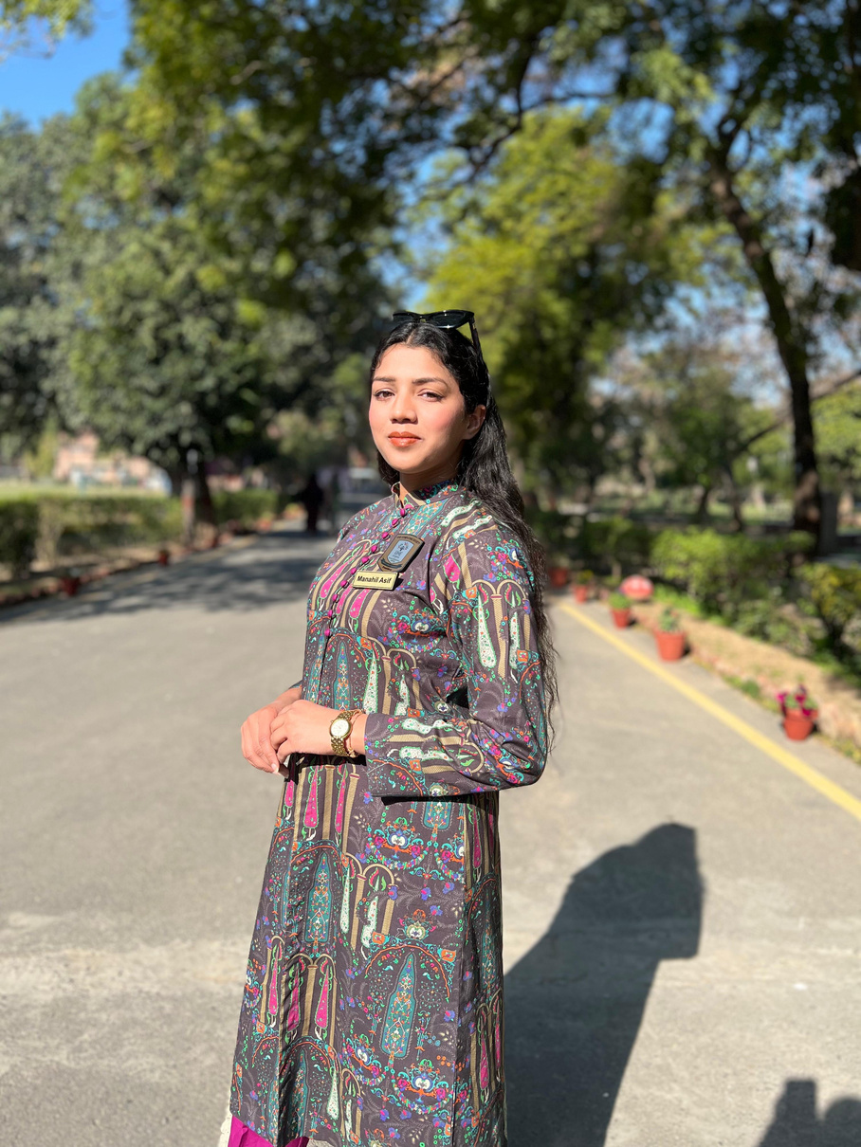
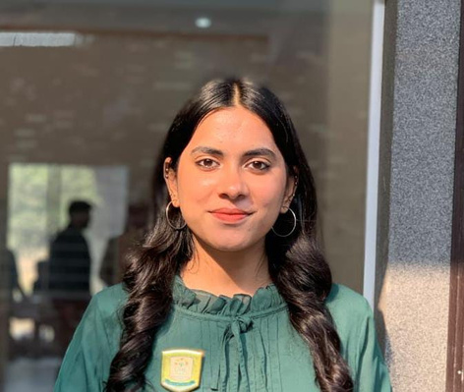


THE TEAM
Manahil Asif
Founder
Malaika Majeed
Co-Founder
Dr.Aniqa Dilawari
Advisor
Ms. Sameen Fatima
Advisor
Dr. Ramsha Haider
Medical Consultant
AI/ML, leadership
App/system design, data management
PhD in Computer Science
AI training, model
development
M.Phil in Computer Science
MBBS Doctor

Slide 12

Thankyou!

